Slide 1
MEDSCI 303
Principles of Pharmacology
Introduction to the
Laboratory Course

Slide 2
Turn your Computers on
Please Logon using the details below:
Login: FMHS\phcol303
Pswd: Pharma14
(also written on the white boards around the room)
Launch NetLogin using your UPI and pswd *before* launching Explorer (or other browser) to have Internet access

Slide 3
Course Manuals – do you have one?
Tutors & Technicians
Pharmacology/Pharmacy Teaching Lab – space for all labs and tutorials
Lab Streams – only switch with permission!
Attendance is compulsory!
- Sign in or you are considered absent

Slide 4
Things to bring to labs
– lab coats, CLOSED foot shoes, calculator, manual, $2 coin
- NO bags, no jackets, no food, no drink bottles
Mobile phone policy
– turned off and/or in the locker or we confiscate it
Lockers
-$2 coin is refunded, do not leave lockers unlocked
Health & Safety
-Signing in next week is your acknowledgment that you read and understood this section on the website.

Slide 5
Cecil & 303 Website
Log onto Cecil
Can you see the Course website when you select
  Current Courses> MEDSCI.303FH
    Course website link in Knowledge Map
    (or flexiblelearning.auckland.ac.nz/medsci303/index.html)
Piazza
Did you receive a welcome email to your AucklandUni email?
Please log on and complete the polls if you have not done so yet

Slide 6
Contacting Staff
Office Hours: (contact details on website and on p.3)
  Liam – Mon 1-2.30pm, Fri 12-1.30pm??
  Leslie – by appointment Wed 2-3pm, Thu 9-10am
  De –
Email - medsci303contact@auckland.ac.nz
Please identify yourself by name and ID!
Phone –identify yourself by name and course
Discussion Forum – Piazza discussion forum, you will receive an email invitation today, if not contact a Tutor
TBD

Slide 7
Student Evaluation 2013
Go to ‘Lab 1: Introduction’ page of website
Open the pdf
Take a few minutes to read it

Slide 8
Student Evaluation 2013
Requirements for the group assignment were clearly explained.
  65.7% Agreed + Strongly Agreed vs. 17.8% Disagreed + Strongly Disagreed.
I was clearly informed how my learning would be assessed
  72.8% Agreed + Strongly Agreed vs. 10.1% Disagreed + Strongly Disagreed.
The volume of work in this course was fair and reasonable.
  64.5% Agreed + Strongly Agreed vs. 14.8% Disagreed + Strongly Disagreed
I received helpful feedback on my learning progress.
  62.1% Agreed + Strongly Agreed vs. 14.2% Disagreed + Strongly Disagreed

Slide 9
Student Evaluation 2013
“What was most helpful to your learning?”
Provision of Lecture Recordings
Staff
Practicals/Laboratories
Resources provided on the course website were helpful

Slide 10
Student Evaluation 2013
“What improvement would you like to see?”
Consistency of marking in the report assessment
Report Writing Tutorial content
Peer assessment component of the report grade was unclear

Slide 11
Expectations of Students
Receptiveness – things we do aren’t just for fun, designed to improve Pharmacology knowledge and multidisciplinary skills
Constructive approach to your learning
  Coming to labs prepared
  Communications with tutors
  “Why?”
  Reflective practice
Academic Integrity

Slide 12
Expectations of Tutors
Courteous and receptive to the needs of students
Fun?
Facilitation of your learning
  Cecil resources and announcements
  Piazza Discussion Forum – link through Cecil
  Medsci 303 website – link through Cecil
Useful feedback on assessments –
please come talk to us if a comment is not clear

Slide 13
Animals / Animal Tissue?
Animals and Animal Tissue are used in our course
Objections – discuss with Tutors
  Live animals only? Alternatives are available.
  All animal work? Reassess whether this course is for you.
Full and rigorous approval has been attained from the University Ethics Committee for all aspects of the course

Slide 14
Assessment Format
Mid-semester test (10%)
Final Exam (50%)
Labs (40%)
  Group Lab Reports – x3 (17%)
  MCQ in-lab tests – x4 (8%)
  Animal Handling Test , MCQs (2.5%)
  Lab Test – lecture slot, last week (12.5%)
Individual Lecturers
Tutors

Slide 15
Lab Reports
Refer to the ‘Writing Lab Reports’ section of the website
Thorough Report-Writing Guides will be provided for each report (decreasing detail as semester progresses)
{These two are the main sources of information. Some details will be conveyed in the lab next week}
Consult Piazza
If in doubt, ask!
Group assessment

Slide 16
Cooperative Learning
NEXT WEEK - You will either be randomly assigned to a groups of 3 or will be allowed to self select a group.
These will be the people you will conduct experiments with each week
All lab reports will be submitted as a group
The mark achieved for the report will be allocated to all the members of the group (scaled on participation)
Peer Evaluation Process

Slide 17
Peer Evaluation
Refer to the Groupwork page on the course website
Peer evaluation to be submitted for each lab report
Will scale each individual’s mark
Anonymous
  Submitted online
  Individuals will get mark via Cecil, no mark on report

Slide 18
Cooperative Learning Grades
Your participation will determine whether you are awarded the full mark for your report.
Report out of 100
Peer review out of 32 (8 categories marked 0-4)
50% of your report mark is fixed and 50% is scaled (50-100%) based on your PE mark i.e. You get a proportion of your mark depending on how you contributed.
32/32 (100%) PE
0%
50% (fixed)
75%
100%
16/32 (50%) PE

Slide 19
Cooperative Learning Grades
Your mark scaled (50-100%) i.e. You get a proportion of your mark depending on how you contributed.
e.g. Report gets 70%
100% PE = 70 marks
0%
(0 marks)
50% fixed
(35 marks)
100%
(70 marks)
50% PE = 52.5 marks

Slide 21
Benefits of Cooperative Learning
More closely related to future work environments.
Better engagement with the material so you can contribute.
More conducive environment to ask questions in.
Teaching is the best way of learning

Slide 22
Potential Problems
Students with a better understanding will do all the work and others will get the marks too.
Group members don’t get on.
Don’t feel like you can mark someone down (friend?)
Someone in the group needs to attend another lab stream.
Someone misses the lab altogether (illness, etc)

Slide 23
Excel Skills
Constructing figures
  Appropriate style (bar, line, pie chart...)
  Axis position and numbering
  Legends
  Fitting curves – linear vs. non-linear regression
  Error bars (SD)

Slide 24
Excel Exercise
On MEDSCI303 course website:
Use left-hand side navigation
Go to Lab 1: Introduction →Pre-lab: Excel Practical
  Find “Serotonin practice sheet” AND
  “Constructing Concentration-Response Curves in Excel”
NOTE: Link to Student Excel Courses run by CAD!

Slide 25
Excel Figure
Figure 1: Contraction of guinea pig ileum in response to serotonin (5-HT). Tissue was stimulated at five minute intervals with increasing concentrations of 5-HT. Estimated pD2 is 6.2. The data are expressed as percentages of maximum response and data points represent mean +/- SD, n=4.
Notes:
Features make it publication-like. No title, labelled axes, error bars and thorough caption. Details for caption are in Word file on Scientific Reasoning subpage of Writing Lab Reports

Slide 26
Prism Figure
Notes:
Using 4 parameter regression. Good fit, no automatic presumptions about sigmoidal trendline.

Slide 27
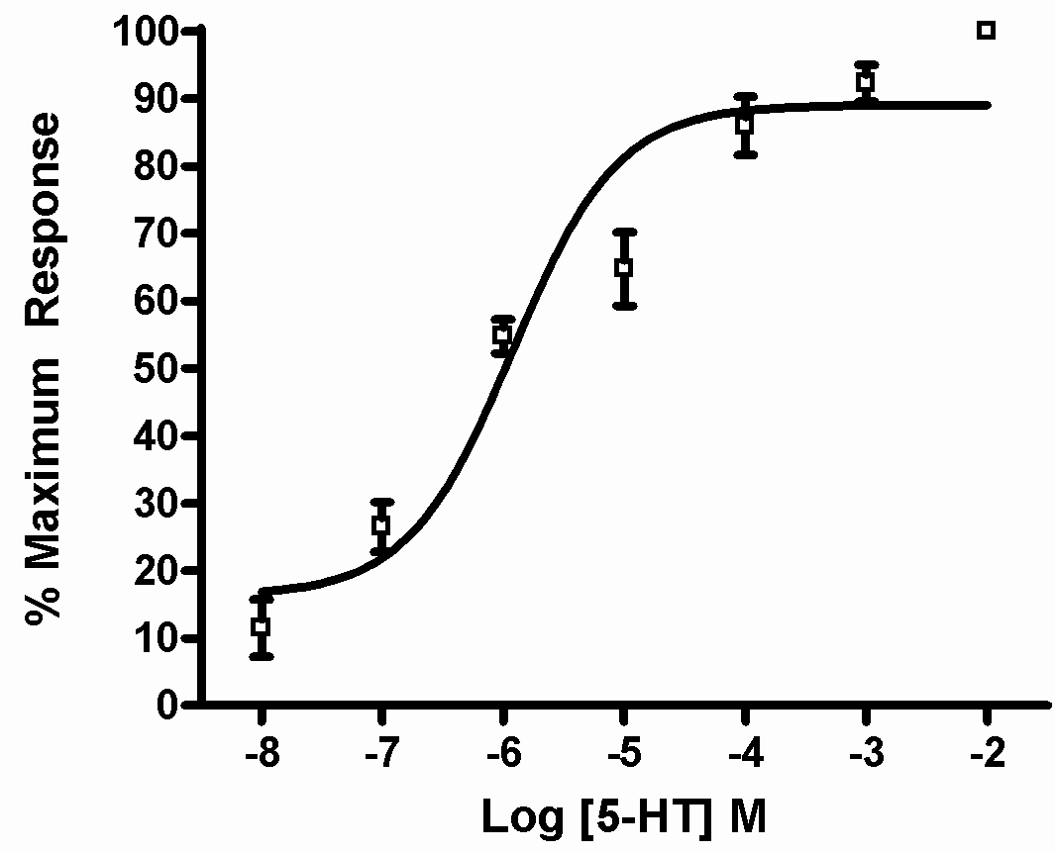
Prism Figure
Figure 1: Contraction of guinea pig ileum in response to Serotonin (5-HT). The data are expressed as the percentage of the maximal response induced by 5-HT. The data increases exponentially without reaching a plateau. pD2 = 5.9. Data points represent mean +/- SD, n= 4.
Notes:
Using three parameter regression. Basically forces a standard sigmoidal fit through the data. Note the difference in pD2 from the previous graph.

Slide 28
Go to page 5 of your manual
Date | Topic | Assessment | Hand-in Date
Mar 3/4 | Laboratory safety & introduction to labs
Mar 10/11 | Potency of Agonist & Antagonist | Report 1
Mar 17/18 | Effects of pH on Absorption | In-lab MCQ
Mar 24/25 | One Compartment model – single dose | In-lab MCQ
Mar 31/Apr 2 | One Compartment model – multiple doses | Report 2
Mid-Semester/Easter Break (Fri 3 April – Sat 18 April)
Apr 21/22 | Lab Report Tutorial
Apr 28/29 | Introduction to Animals | In-lab MCQ
May 5/6 | Routes of Drug Administration | Report 3
May 12/13 | Induction/inhibition in vivo | In-lab MCQ
May 19/20 | Induction/inhibition in vitro | In-lab MCQ
May 26/27 | PK problems
June 2/3 | No Labs

Slide 29
Assessment Dates
Report 1 – Due 12am (midnight) SUNDAY March 22nd
Report 2 – Due 12am (midnight) SUNDAY Apr 26th
Report 3 – Due 12am (midnight) SUNDAY May 17th
Hand in via Turnitin only! Details will be provided prior to submission deadlines.
Notes:
Due dates allow 11-12 days to complete the report. Includes two weekends (time to do report?), one lab session and a full week of office hours (plenty of time to get help).

Slide 30
Vote for how groups are made
https://piazza.com/class/i4xblyog9ap5oh?cid=7
Piazza, @7
Voting closes 12pm (midday) Friday.
Notes:
GO AND VOTE

Slide 31
Penalties
All laboratories must be completed to a satisfactory standard, which includes, but is not limited to, participation and submission of results to a class data sheet.
Failure to complete laboratories to a satisfactory standard will result in a penalty of up to -4.5% per affected laboratory
(that means 4.5% out of 40% for the labs – makes it hard to pass the practical component!)
Laboratory reports submitted after the deadline will lose 10% of the marks allocated to that report per 24 hour period or part thereof late
(i.e. up to 24h late = -10%, up to 48h late = -20% etc).

Slide 32
Lab Test – lecture slot
45 mins, 25 marks, 12.5%
17-25 short answer questions
All questions based on learning objectives or class data from non-report labs
Example questions have been posted on Cecil
Preference for time? Piazza @8
Notes:
Class data related questions will be broad, so trend-based, rather than “What did group 10 get for the Metabolism in vitro lab?”
No past papers to avoid rote learning of previous questions. At Stage 3 students should be focussed on understanding rather than recognition and recall.
Lab Test can either be during lecture slot Wed June 3 with all in 505.007 or can be split over two rooms 6pm Tue Jun 2.

Slide 33
Student Reps
Give student feedback where necessary to course coordinator
Help out your fellow classmates
Add a little extra something to your CV
Little work – attend 2 meetings of class reps in the semester
Organise a class party? (No longer funded ☹)

Slide 34
S.A.M.S
Student Association for the Medical Sciences
See pdf file on Cecil or on Medsci 303 website homepage.

Slide 35
Intro to Organ Baths
Designed for studying isolated tissue
- a pharmacology screening tool to determine the concentration-response relationship in a contractile tissue
Keep tissue alive by providing
  Nutrients in the Krebs solution
  Carbogen gas (95% O₂ / 5% CO₂)
  (keep an eye on these bubbles during the lab)
  Warmth via heated Krebs solution

Slide 36
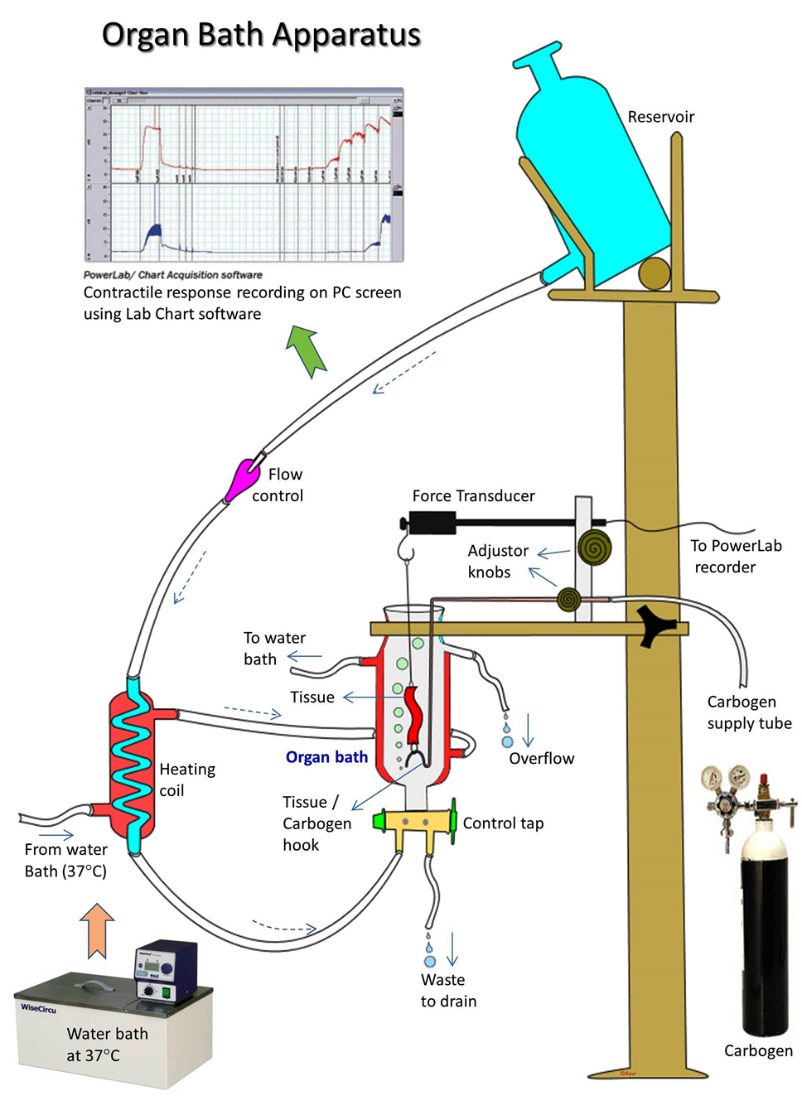
(Telang, 2014)

Slide 37
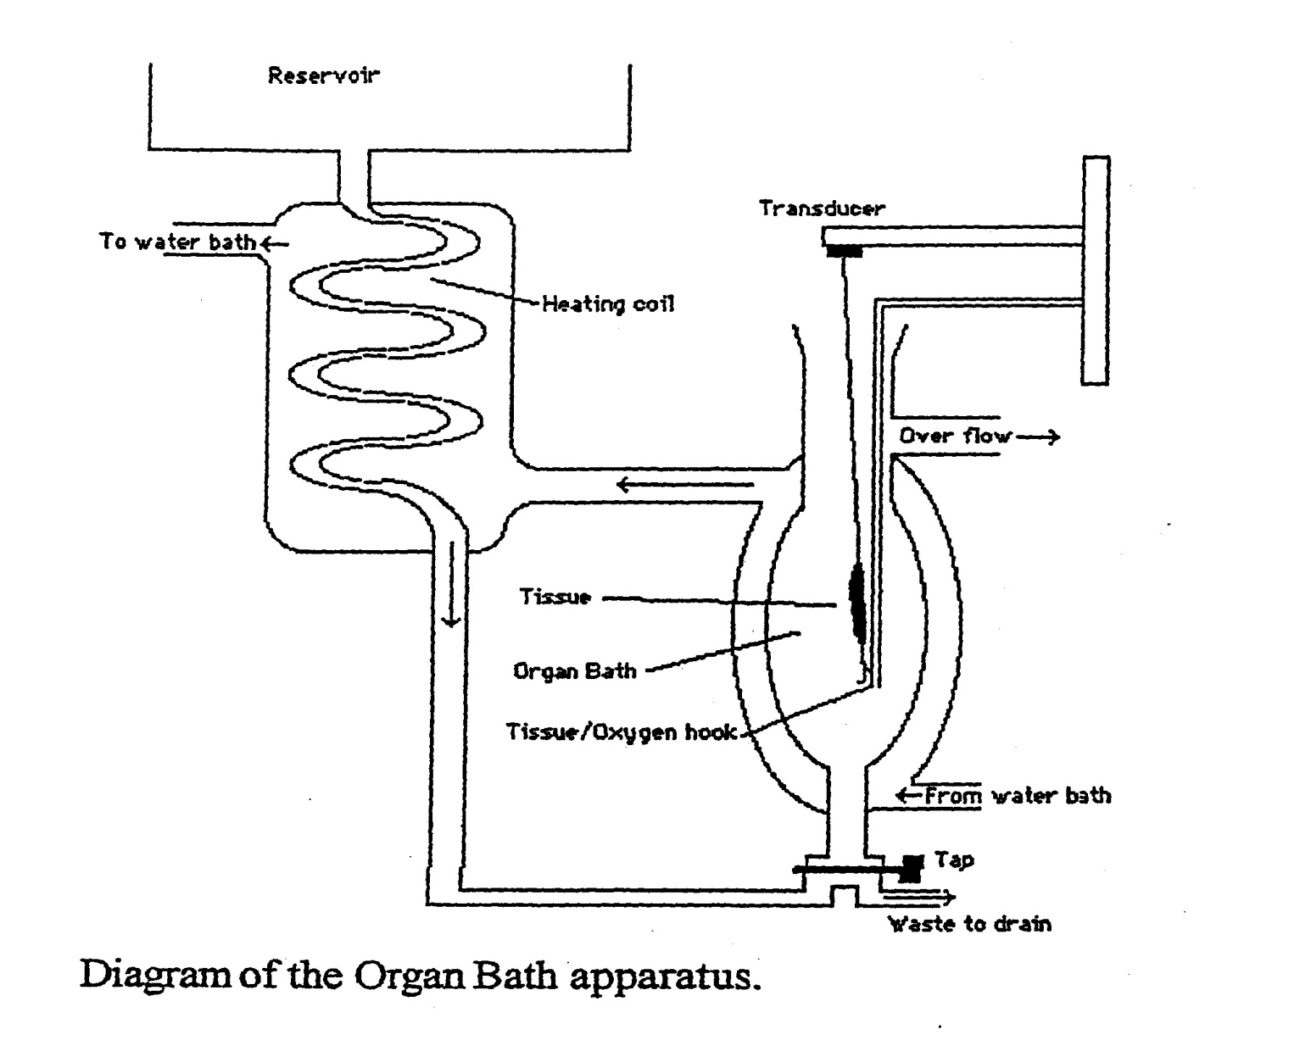
Intro to the Organ Bath – The Bath
Krebs
Organ Bath
Tap to Drain and Refill
Everyone drain and refill your bath one time now!

Slide 38
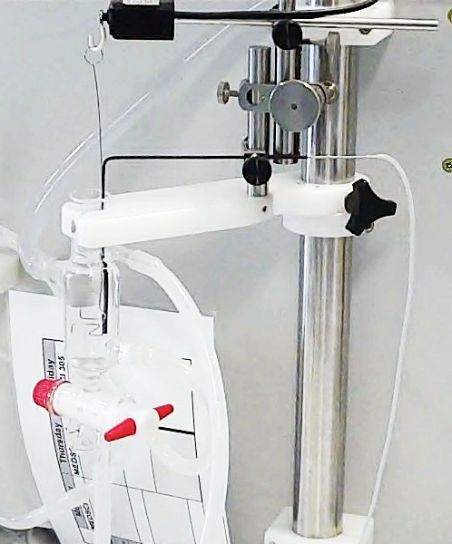
Intro to the Organ Bath – Surrounding Apparatus
B) Do Not Touch!
C) Unhook
from force transducer
to suspend tissue
A) Adjust
resting tension
D) Loosen to remove
carbogen hook
Tissue hooks

Slide 39
Organ Bath Processes
Put hooks back in (will have tissue attached for you next week)
See bubbles? Approx 2/sec? Try adjusting carbogen flow (gently!)
Tip beaker of water in to reservoir
Practice emptying and refilling organ bath using tap

Slide 40
BEFORE LEAVING:
Leave organ bath overflowing (will drain reservoir)
Close programs - do NOT save changes and do NOT save files onto the desktop
Log off computers
Push stools under benches
Tidy away mouse, keyboard etc.

