Slide 1
CourseBuilder
New features

Slide 2
Tab Colours

Slide 3
Right-hand Navigation

Slide 4
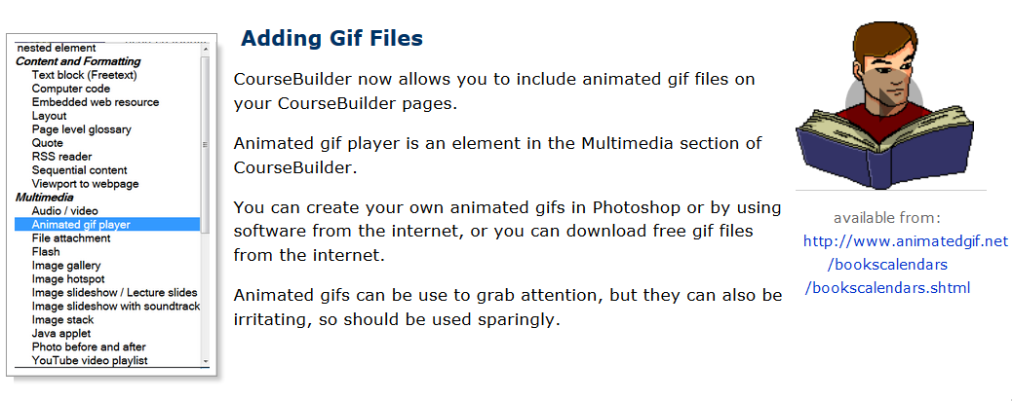
Animated Gif player

Slide 5
Conditional Release

